Slide 1
Reward-Oriented Task Offloading Under Limited Edge Server Power for Multiaccess Edge Computing Minseok Song , Yeongju Lee and Kyungmin Kim
Adarssh KG :CB.SC.U4CSE23658
Ravindran G :CB.SC.U4CSE23647
Pratyush Yadav :CB.SC.U4CSE23641
Paarthu Reddy: CB.SC.U4CSE23639

Slide 2
Problem Justification
Understanding the idea

Slide 3
How to maximize the total reward for the Edge infrastructure providers while operating within strict power consumption limits of edge servers .
Specific problems :
1. Task Allocation decision : determining which computational task from IOT devices should be offloaded to which edge servers
2. Power budget constraints: Operating within a predefined maximum power limit across all edge servers (inequality: ∑Pⱼ(Uⱼᵗᵒᵗᵃˡ) ≤ Pₗᵢₘᵢₜ)
3. Reward optimization : Maximizing the total profit/revenue earned by EIPs from processing offloaded tasks
4. Resource capacity limits: Ensuring edge server processing capacities are not exceeded
The authors formulate this as the ESA-MAUD (Edge Server Allocation and Maximum Allowable Utilization Determination) problem.

Slide 4
Why is it an edge problem?
Resource scarcity at the network edge : They have limited computational capacity , thus making efficient resource allocation critical.
Power consumption challenges : Unlike the cloud they must operate within local power constraints
Proximity based service delivery: reducing the latency by processing tasks closer to the user , creates the coverage constraint problem.
Multi-Tenant resource sharing : Addresses scenarios where edge servers are shared between multiple customers/applications, which is a common deployment model in edge computing to improve resource utilization and economic efficiency

Slide 5
Proposed Solution :
Phase 1 : Maximum allowable utilization determination (MUD)
To determine the maximum CPU workload each edge server can safely handle so that the total power consumed by all servers stays within the system’s power limit.
This sets a power aware workload cap for every server, ensuring no overload and laying the foundation for efficient task assignment in the next phase.
Phase 2 : Edge server allocation (EAP)
Aim is to allocate individual tasks to specific edge servers to maximize the total reward within the utilization constraints established by phase 1.
Task allocation
Reward maximization

Slide 6
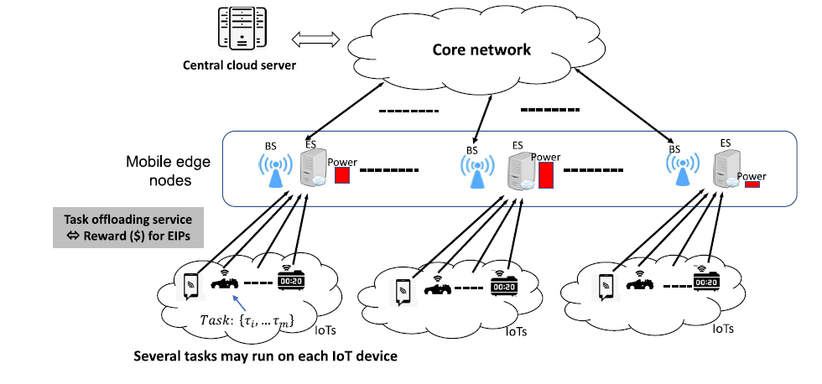
SYSTEM ARCHITECTURE

Slide 7
Maximum allowable utilization determination (MUD)
Phase 1

Slide 8
Objective of Phase 1 (MUD):
Determine the maximum CPU utilization (workload) each edge server can handle without exceeding the overall system power limit.
Select a set of tasks and utilization caps that maximize the total reward (profit) while respecting edge server power constraints.
Provide these utilization caps to be used as constraints in Phase 2 task allocation.

Slide 9
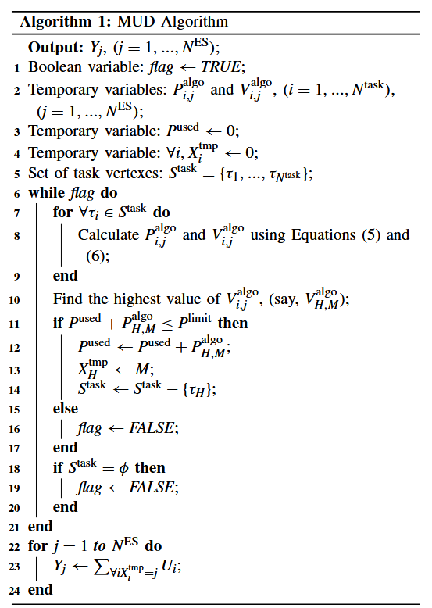
Set current utilization of each server to 0
Set total used power to 0.
List all tasks as unassigned
While total power < power cap and unassigned tasks exist:
For each unassigned task
Calculate extra reward and power.
Calculate efficiency = reward / power.
Select assignment with highest efficiency
If total power after assignment < cap
Assign task , update utilization and power
Remove task from unassigned list
Else :
Stop assignment
Output utilization caps (sum of assigned CPU tasks) for each server.

Slide 10
Phase 1 Formulas:
Reward for Assigning Task:
Ri,jRi,jNet profit earned by assigning task ii to server jj.
Extra Power Consumption:
Pi,jPi,jAdditional power used if task i is assigned to server j.
Efficiency Metric:
Efficiencyi,j=Ri,jPi,jEfficiencyi,j=Pi,jRi,jReward obtained per extra unit of power consumed.
Selection Rule:
(i∗,j∗)=arg⁡max⁡Ri,jPi,j(i∗,j∗)=argmaxPi,jRi,jPick the task-server pair with maximum efficiency.
Assign only if:
∑jPjtotal+Pi∗,j∗≤Plimitj∑Pjtotal+Pi∗,j∗≤Plimit

Slide 11
Edge server allocation problem (EAP)
Phase 2

Slide 12
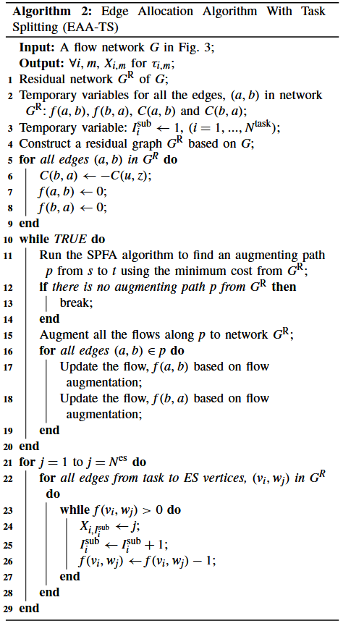
EAP with task splitting
“Splitting the task, not the performance.”
1. Solves task offloading using a flow network and residual graph model. 2. Uses SPFA (Shortest Path Faster Algorithm) to find minimum-cost augmenting paths.
3. Maximizes total reward under limited edge power.
4. Updates flows for each task-server pair; selects best split combinations.
WHILE (there is a shortest and a cheapest path exists from source to sink in the residual graph): do
- Find the path using SPFA. - For each edge (a → b) along that path:
- Update the forward flow f(a, b) and the reverse flow f(b, a).
For every edge from a task vᵢ to an edge server wⱼ, it checks if there's any remaining flow (f(vᵢ, wⱼ) > 0) and while the flow is there, It assigns that portion of the task to server j using the variable Xᵢ,ˢᵘᵇ and increments the task split counter and reduces the flow value by 1 to reflect assignment.
5. Output: Assignment of split tasks to ESs without violating power constraints.

Slide 13
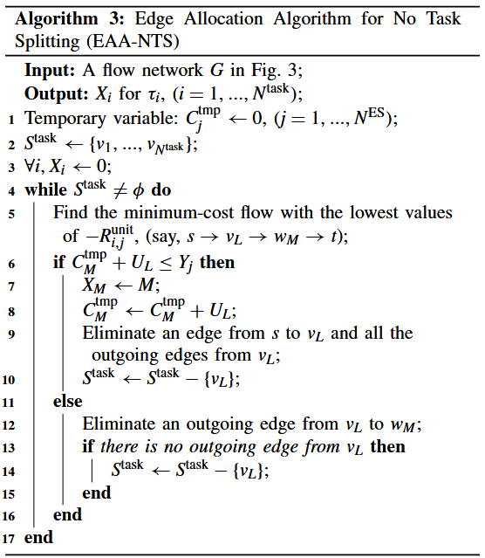
Eap with no task splitting
Greedy Task Offloading Without Splitting
1. Uses reward-per-unit cost (−Rᵢⱼᵘⁿⁱᵗ) as a greedy metric to select the best task-server path.
2. Ensures no server exceeds its power budget (Yⱼ)
3. While there are unassigned tasks:
Find the path with the highest reward-per-cost (lowest −Rᵢⱼᵘⁿⁱᵗ).
If the selected edge server has enough remaining power : then
*Assign the task to this server
**Update the server’s used power
***Remove this task and all its paths from the graph
otherwise : do
* Remove the current edge and try alternatives
If no more paths exist from the task:
Discard the task
4. Removes tasks and paths progressively until all are allocated or discarded.

Slide 14
Language: Python Libraries: Numpy, Pandas, NetworkX, Google OR-Tools. Data input: Small to medium scale simulated data sets (servers, tasks, coverage). Output: Console print, CSV files, plots for validation. simulation environment on PC/laptop.
Implementation strategy

Slide 15
Language: Python Libraries: Numpy, Pandas, NetworkX, Google OR-Tools. Data input: Small to medium scale simulated data sets (servers, tasks, coverage). Output: Console print, CSV files, plots for validation. simulation environment on PC/laptop.
Implementation strategy
The implementation will be carried out entirely in Python, using NumPy and Pandas for data handling, NetworkX for graph-based task allocation modeling, and Google OR-Tools for optimization. We will work with small to medium-scale simulated datasets representing servers, tasks, and coverage information. The simulation will produce console outputs, CSV files for results storage, and plots for performance validation, all running on a PC or laptop without requiring specialized hardware.

Slide 16
State of the art literature Energy-Aware Workload Offloading in Vehicular Edge Computing
Pros
*Saves vehicle battery by minimizing energy use.
*Meets strict task delay requirements.
*Considers mobility and network changes.
Cons
*Ignores edge server power optimization.
*Higher computation cost for large networks.
*No profit/reward consideration.
https://doi.org/10.1109/ACCESS.2019.2894257
The Energy-Aware Workload Offloading in Vehicular Edge Computing paper proposes a system that decides whether a vehicle’s task should run locally or be offloaded to a roadside edge server, aiming to minimize vehicle energy use while meeting strict delay limits. It considers mobility, network quality, and server resources to offload only energy-saving tasks without deadline violations.

Slide 17
State-of-the-Art Literature Profit-aware Resource Management for Edge Computing https://doi.org/10.1145/3213344.3213349
This paper uses market equilibrium pricing to allocate CPU, memory, and bandwidth fairly in multi-tenant edge computing, maximizing user utility while matching supply and demand. It does not address server power limits or reward-to-power trade-offs.
Example:
It works like an online marketplace for computer power. If many people want to use the edge servers, the “price” goes up so only those who need it most take it, making sure resources are shared fairly.

Slide 18
Pros
Fair sharing of resources among multiple users.
Adapts automatically to changing demand.
Maximizes overall benefit for all users.
Cons
Doesn’t consider how much power the servers use.
No focus on maximizing provider profit.
More useful for shared-resource fairness than for strict power-limited scenarios.

Slide 19
Task allocation

Slide 20
Adarssh – cb.sc.u4cse23658 | System modelling: Defining edge servers specifications and tasks
Paarthu – cb.sc.u4cse23639 Ravindran – cb.sc.u4cse23647 | MUD algorithm implementation : (Phase 1)
Pratyush – cb.sc.u4cse23641 Adarssh – cb.sc.u4cse23658 | EAP algorithm implementation : (Phase 2)

Slide 21
Thank you

